Slide 1
Sampling Distribution of
When the population has a normal distribution, the sampling distribution of is normally distributed for any sample size.

Slide 2
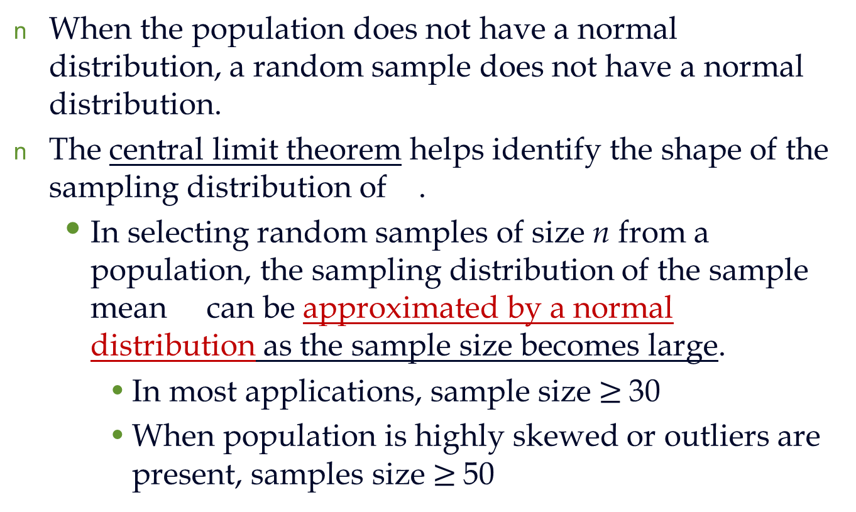
Sampling Distribution of
When the population does not have a normal distribution, a random sample does not have a normal distribution.
The central limit theorem helps identify the shape of the sampling distribution of .
In selecting random samples of size n from a population, the sampling distribution of the sample mean can be approximated by a normal distribution as the sample size becomes large.
In most applications, sample size $≥$30
When population is highly skewed or outliers are present, samples size $≥$50

Slide 3
Sampling Distribution of
Why do we need to learn sampling distribution of ?
The sampling distribution of can be used to provide probability information about how close the sample mean is to the population mean μ .
Use E( ) and σ to calculate z-score

Slide 4
Sampling Distribution of for SAT Scores
Example: St. Andrew’s College
Population mean = 1697
Population standard deviation =87.4
n=30; N=900
n/N=30/900 $≈0.03<0.05=⇒ infinite population$

Slide 5
Example: Sampling Distribution of
St. Andrew’s College
What is the probability that a simple random sample of 30 applicants will provide an estimate of the population mean SAT score that is within +/−10 of the actual population mean μ ?
In other words, what is the probability that will be between 1687 and 1707?

Slide 6
Example: Sampling Distribution of
St. Andrew’s College
1. Calculate the z-value at the upper endpoint of the interval.
2. Find the area under the curve to the left of the upper endpoint.
NORMSDIST(0.63)
z = (1707 - 1697)/15.96= 0.63
P(z < 0.63) =0.7357

Slide 7
Sampling Distribution of
Example: St. Andrew’s College
Sampling
Distribution
of
for SAT
Scores
Area = 0.7357
1697
1707

Slide 8
Example: Sampling Distribution of
St. Andrew’s College
3. Calculate the z-value at the lower endpoint of the interval.
4. Find the area under the curve to the left of the lower endpoint.
NORMSDIST(-0.63)
z = (1687 - 1697)/15.96= - 0.63
P(z < -0.63) = 0.2643

Slide 9
Sampling Distribution of for SAT Scores
Example: St. Andrew’s College
Sampling
Distribution
of
for SAT
Scores
Area = 0.2643
1687
1697

Slide 10
Example: Sampling Distribution of
St. Andrew’s College
5. Calculate the area under the curve between the lower and upper endpoints of the interval.
6. The probability that the sample mean SAT score will be between 1687 and 1707 is:
P(-0.63 < z < 0.63) = P(z < 0.63) - P(z < -0.63)
= 0.7357 - 0.2643
= 0.4714
P(1687 < < 1707) = 0.4714

Slide 11
Sampling Distribution of for SAT Scores
Example: St. Andrew’s College
Sampling
Distribution
of
for SAT
Scores
Area = 0.4714
1687
1697
1707

Slide 12
Sample Size and the Sampling Distribution of
St. Andrew’s College
Suppose we select a simple random sample of 100 applicants instead of the 30 originally considered.
E( ) = μ = 1697
regardless of the sample size.
n/N=100/900=0.1>0.05, hence, we shall use the formula
With the increase in the sample size to n = 100, the standard error of the mean is decreased from 15.96 to 8.2
Sample size increases ➔ σ decreases.

Slide 13
Sample Size and the Sampling Distribution of
Example: St. Andrew’s College
With n = 100,
With n = 30,
A larger sample size provides a higher probability that the sample mean is within a specified distance of the population mean.

Slide 14
Example: Sampling Distribution of
St. Andrew’s College: sample size = 100
The probability that the sample mean SAT score will be between 1687 and 1707 is:
Please check and see if you can get this probability by yourself.
P(1687 < < 1707) = 0.7774

Slide 15
Is the sample estimate a good enough point estimator?

Slide 16
Properties of Point Estimators
Before using a sample statistic as a point estimator, statisticians check to see whether the sample statistic has the following properties associated with good point estimators.
Unbiased
Efficiency
Consistency

Slide 17
Properties of Point Estimators
Unbiased
If the expected value of the sample statistic is equal to the population parameter being estimated, the sample statistic is said to be an unbiased estimator of the population parameter.

Slide 18
Properties of Point Estimators
Efficiency
Given the choice of two unbiased estimators of the same population parameter, we would prefer to use the point estimator with the smaller standard deviation, since it tends to provide estimates closer to the population parameter.
The point estimator with the smaller standard deviation is said to have greater relative efficiency than the other.

Slide 19
Properties of Point Estimators
Efficiency
E.g, we know that both the mean and the median are two measures of central location.
When sampling from a normal population, the standard error of the sample mean is less than the standard error of the sample median. Thus, the sample mean is more efficient than the sample median.

Slide 20
Properties of Point Estimators
Consistency
A point estimator is consistent if the values of the point estimator tend to become closer to the population parameter as the sample size becomes larger.

